Slide 1
Resistive Network Analysis
To illustrate the fundamental techniques for the analysis of resistive circuits.
To define network variables and network analysis problems
Two most widely applied methods are introduced _________ and ______________

Slide 2
Resistive Network Analysis
To illustrate the fundamental techniques for the analysis of resistive circuits.
To define network variables and network analysis problems
Two most widely applied methods are introduced— node analysis and mesh analysis

Slide 3
Resistive Network Analysis
One method is based on principle of superposition, which is applicable only to linear circuits.
Concept of Thévenin and Norton equivalent circuits is explored

Slide 4
Network Analysis
The analysis of an electrical network consists of determining each of the unknown branch currents and node voltages.
To define all the relevant variables as clearly as possible, and in systematic fashion.

Slide 5
Network Analysis
How can we conduct “Network Analysis”?

Slide 6
Network Analysis
How can we conduct “Network Analysis”?
Once the known and unknown variables have been identified, a set of equations relating these variables is constructed, and
These equations are solved by means of suitable techniques.

Slide 7
Network Analysis
How can we conduct “Network Analysis”?
The analysis of electric circuits consists of writing the smallest set of equations sufficient to solve for all the unknown variables.

Slide 8
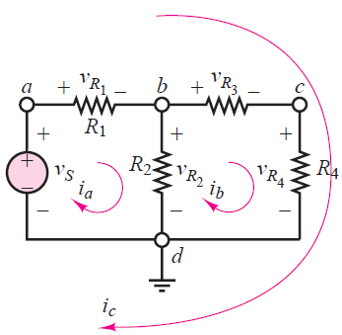
Network Analysis -Examples
Please identify the branch and node voltages and the loop and mesh currents in the circuit

Slide 9
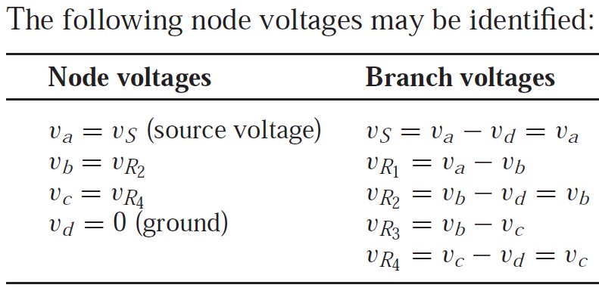
Network Analysis -Examples
Please identify the branch and node voltages and the loop and mesh currents in the circuit

Slide 10
Network Analysis -Examples
Currents ia, ib, and ic are loop currents, but only ia and ib are mesh currents

Slide 11
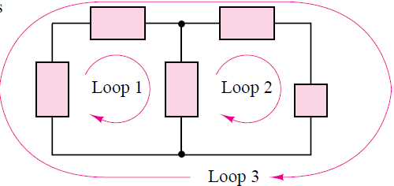
Electrical Network - Loop
A loop is any closed connection of branches
How many loops?

Slide 12
Electrical Network - Mesh
A mesh is a loop that does not contain other loops. Meshes are an important aid to certain analysis methods.
A loop is any closed connection of branches

Slide 13
Network Analysis -Examples
Have identified a total of 9 variables!

Slide 14
NODE VOLTAGE METHOD
Node voltage analysis is the most general method for the analysis of electric circuits.
Its application to linear resistive circuits

Slide 15
NODE VOLTAGE METHOD
The node voltage method is based on defining the voltage at each node as an independent variable.
One of the nodes is selected as a reference node (usually—but not necessarily—ground), and
Each of the other node voltages is referenced to this node.

Slide 16
NODE VOLTAGE METHOD
Once each node voltage is defined, Ohm’s law may be applied between any two adjacent nodes to determine the current flowing in each branch.
In the node voltage method, each branch current is expressed in terms of one or more node voltages; thus, currents do NOT explicitly enter into the equations.

Slide 17
NODE VOLTAGE METHOD
How to define branch currents in this method?

Slide 18
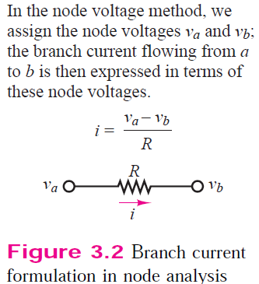
NODE VOLTAGE METHOD
How to define branch currents in this method?

Slide 19
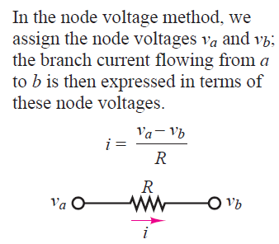
NODE VOLTAGE METHOD
How to define branch currents in this method?
Branch current formulation in node analysis

Slide 20

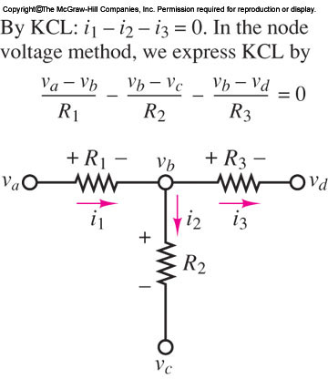
NODE VOLTAGE METHOD
Once each branch current is defined in terms of the node voltages, Kirchhoff’s current law is applied at each node:
Use of KCL in node analysis

Slide 21
NODE VOLTAGE METHOD
FOCUS ON METHODOLOGY
NODE VOLTAGE ANALYSIS METHOD
1. Select a reference node (usually ground). This node usually has most elements tied to it. All other nodes are referenced to this node.
2. Define the remaining n − 1 node voltages as the independent or dependent variables. Each of the m voltage sources in the circuit is associated with a dependent variable. If a node is not connected to a voltage source, then its voltage is treated as an independent variable.
3. Apply KCL at each node labeled as an independent variable, expressing each current in terms of the adjacent node voltages.
4. Solve the linear system of n − 1 − m unknowns.

Slide 22
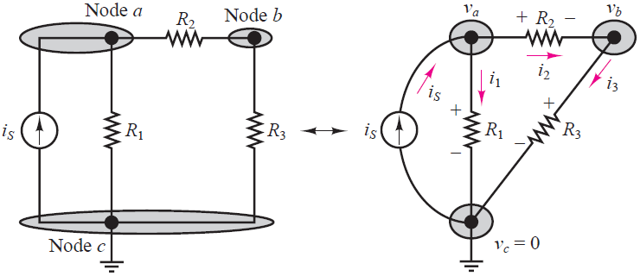

NODE VOLTAGE METHOD
Application of KCL at node a yields
Application of KCL at node b yields
Application of KCL at node c yields

Slide 23
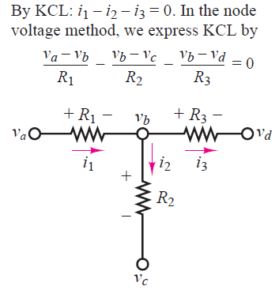
NODE VOLTAGE METHOD
How to define branch currents in this method?
Use of KCL in node analysis

Slide 24

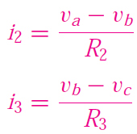
Node Voltage Method
In applying the node voltage method, the currents i1, i2, and i3 are expressed as functions of va, vb, and vc, the independent variables.
Ohm’s law requires that i1, for example, be given by
It is the potential difference va −vc across R1 that causes current i1 to flow from
node a to node c.

Slide 25
Node Voltage Method
Ohm’s law requires that i1, for example, be given by

Slide 26
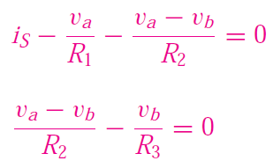
Node Voltage Method
Substituting the expression for the three currents in the nodal equations (following equations), obtain the following relationships:
Application of KCL at node a yields
Application of KCL at node b yields

Slide 27
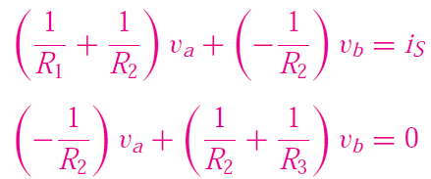
Node Voltage Method
The same equations may be reformulated as follows

Slide 28
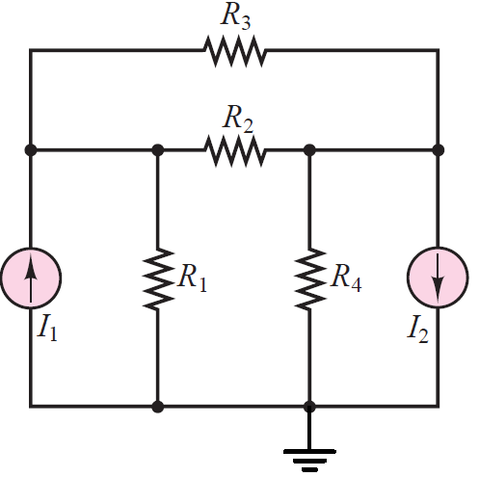
Node Voltage Method -Example
Solve for all unknown currents and voltages in the circuit

Slide 29
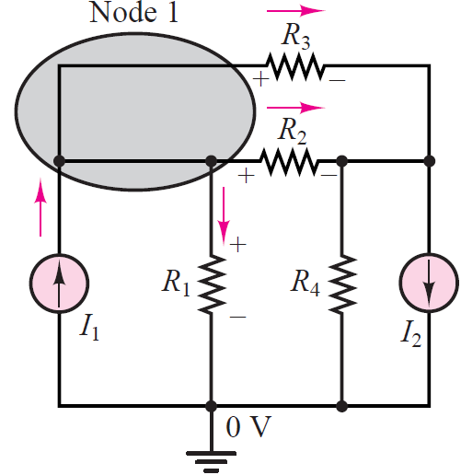
Node Voltage Method -Example
Solve for all unknown currents and voltages in the circuit

Slide 30
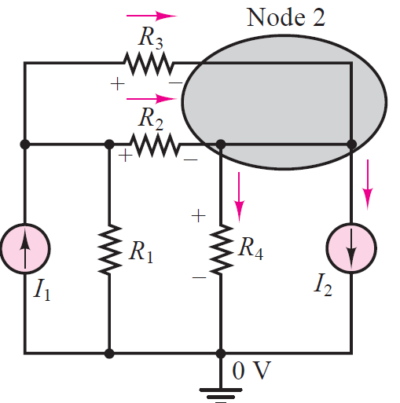
Node Voltage Method -Example
Solve for all unknown currents and voltages in the circuit

Slide 31
Node Voltage Method -Example
Solve for all unknown currents and voltages in the circuit

Slide 32
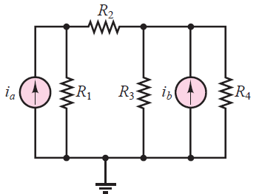


Node Voltage Method -Example
Node Analysis: Write the nodal equations and solve for the node voltages in the circuit

Slide 33
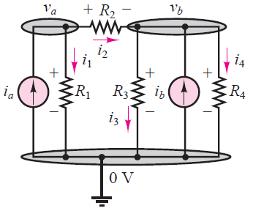
Node Voltage Method -Example
Node Analysis: Write the nodal equations and solve for the node voltages in the circuit

Slide 34
Node Voltage Method -Example
Node a:
Node b:

Slide 35
References
Giorgio Rizzoni, “Fundamentals of Electrical Engineering”, McGraw- Hill Education, 2009. ISBN. 978-0-07-338037-7
Peyton Z. Peebles (Author), Tayeb A. Giuma, Principles of Electrical Engineering (Mcgraw Hill Series in Electrical and Computer Engineering), Mcgraw-Hill College, 1991.
Allan R. Hambley, Electrical Engineering: Principles and Applications, Prentice Hall, ISBN-0132130068, 9780132130066, 2011.

